Slide 1
Instructions for use
These slides provide an introduction to generative AI, guidance on its use in assessments, and include prompts for discussions and interactive teaching moments. The slides are merely a template and should be adapted for use with your department or programme. Slides such as this one with a stone-coloured background contain instructions for staff and should be deleted before use.
The slides are designed as a 1-hour lecture. This lecture could be delivered live in induction week, later in term 1 within a core module, or circulated to students as an asynchronous video.
Please refer to the AI and You teaching toolkit for further guidance.

Slide 2

AI and You
A Guide to the Use of Generative AI in Your Education

Slide 3
Session outline
1. What is Artificial Intelligence?
2. Is it appropriate to use AI tools in your education?
4. What are our next steps?
3. What are UCL’s rules on academic integrity and AI?

Slide 4
1. What is Artificial Intelligence?

Slide 5

What is Artificial Intelligence?
Artificial Intelligence is a field of scientific research and development. It includes subfields such as machine learning which uses algorithms to analyse huge amounts of data.
The machine learning algorithms that are generating the most headlines – ‘deep learning’ and ‘neural networks’ – have themselves been around for more than 40 years.
Generative AI is a recent example of neural networks and the focus of this presentation.
Notes:
https://unesdoc.unesco.org/ark:/48223/pf0000376709

Slide 6
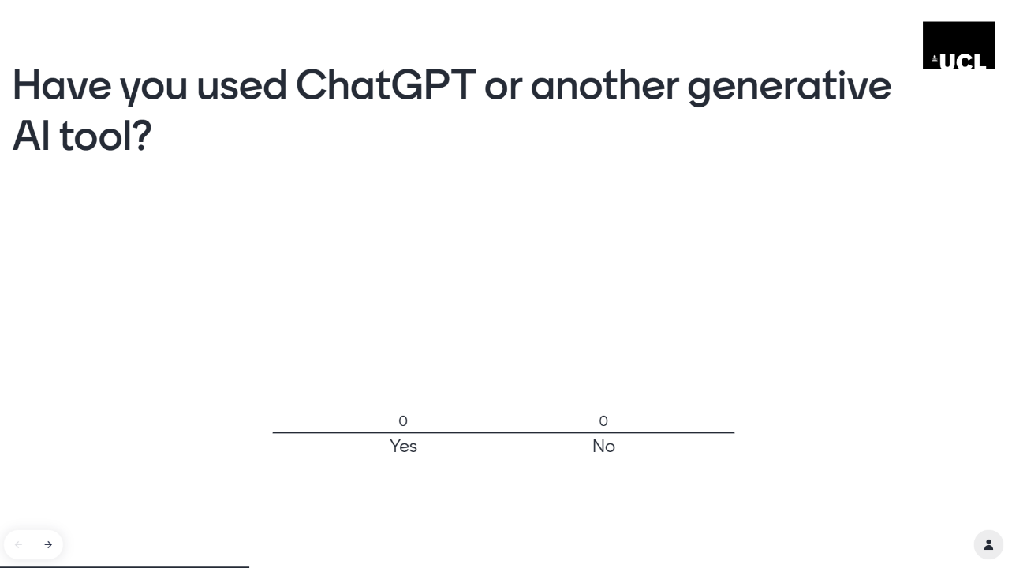
Have you used ChatGPT or another Generative AI tool?
Notes:
The mentimeter can be found as a template. Log in to mentimeter.com using Single Sign On (SSO). Click on “Shared templates” and search for “AI and You”.

Slide 7

What can Artificial Intelligence generate?
Large language models such as ChatGPT can generate text in multiple languages and styles. They can also interpret text and images.
Generative programs such as DALL.E2 and Midjourney generate images from text instructions. Others can generate video, audio, and code.
AI will be increasingly blended into everyday software as a task assistant.
ChatGPT has an increasing list of plugins that extend the natural language model to connect to services, data, and calculations.

Slide 8
What are large language models (LLMs)?
Large language models (LLMs) are a type of advanced artificial intelligence system. ChatGPT is an example of an LLM that allows people to interact with a computer in a more natural and conversational way.
GPT stands for “Generative Pre-trained Transformer” and is the name given to a family of natural language models developed by OpenAI. There are other large language models such as Bard, LLaMA, and Claude.
These tools are known as generative AI because of their ability to produce seemingly original results.
They are trained on large text datasets to learn to predict the next word in a sentence and, from that, generate coherent and compelling responses. GPT-3 is trained on 300 billion words.
Notes:
https://www.iesalc.unesco.org/wp-content/uploads/2023/04/ChatGPT-and-Artificial-Intelligence-in-higher-education-Quick-Start-guide_EN_FINAL.pdf

Slide 9
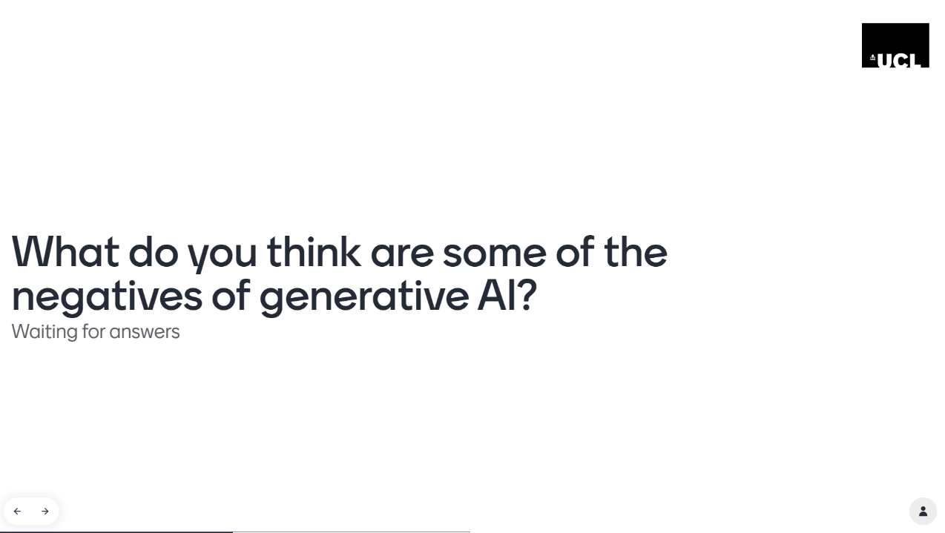
What do you think are some of the negatives of generative AI?
Notes:
The mentimeter can be found as a template. Log in to mentimeter.com using Single Sign On (SSO). Click on “Shared templates” and search for “AI and You”.

Slide 10
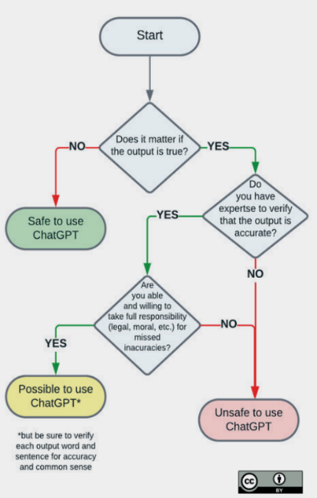
What are its limitations?
LLMs are highly trained text-predictors. Their responses are based on probable language. Factual information may therefore contain inaccuracies that sound plausible but are often entirely incorrect. For example, LLMs may invent quotes, references, or coding libraries.
LLMs only have access to the data they were trained on and therefore don’t have access to current information.
LLMs cannot perform complex computations and are not perfect at interpreting language. They simply predict the most likely sequence of words.
Does it matter if the output is inaccurate?
Notes:
Image: https://www.iesalc.unesco.org/wp-content/uploads/2023/04/ChatGPT-and-Artificial-Intelligence-in-higher-education-Quick-Start-guide_EN_FINAL.pdf

Slide 11
What are the broader ethical issues?
Regulation There is currently no regulation of generative AI. Its rapid development has caused apprehension for many leading figures and calls to pause its development.
Privacy and data Generative AI is built on information scraped from the internet without permission and often in violation of intellectual property rights. OpenAI has no data regulation policy and may collect sensitive information from users through prompts.
Cognitive bias Generative AI has no ethical principles. It is a tool that collects information from databases and texts it processes on the internet. Its predictions repeat the cognitive biases found in that information.
Environment Training LLMs produce significant carbon emissions. Researchers suggest that training ChatGPT-3, for example, generated 552 tons of carbon dioxide. Equivalent to 123 petrol cars driven for one year.
Human rights Generative AI requires invisible human labour to build and cleanse. OpenAI employed workers in Kenya in gruelling conditions for less than $2 an hour.
Notes:
https://theconversation.com/chatgpt-is-a-data-privacy-nightmare-if-youve-ever-posted-online-you-ought-to-be-concerned-199283
https://theconversation.com/is-generative-ai-bad-for-the-environment-a-computer-scientist-explains-the-carbon-footprint-of-chatgpt-and-its-cousins-204096
https://time.com/6247678/openai-chatgpt-kenya-workers/

Slide 12
2. Is it appropriate to use generative AI?

Slide 13
Option 1: Discuss student perspectives on different tools
The purpose of this activity is to discuss student perspectives on the use of different tools in the context of their discipline.
You could, for example, use a mentimeter (see next slide) to collect student opinions on whether it is appropriate to use calculators, spellcheckers, translators, search engines, or ChatGPT.
Context and purpose are the key points. A calculator would not be acceptable in a mental arithmetic test, for example, because the purpose is for a student to demonstrate their learning without the aid of technology.
You could expand this into a discussion on what are and are not appropriate tools in your disciplinary context and how the learning objectives might affect this.

Slide 14
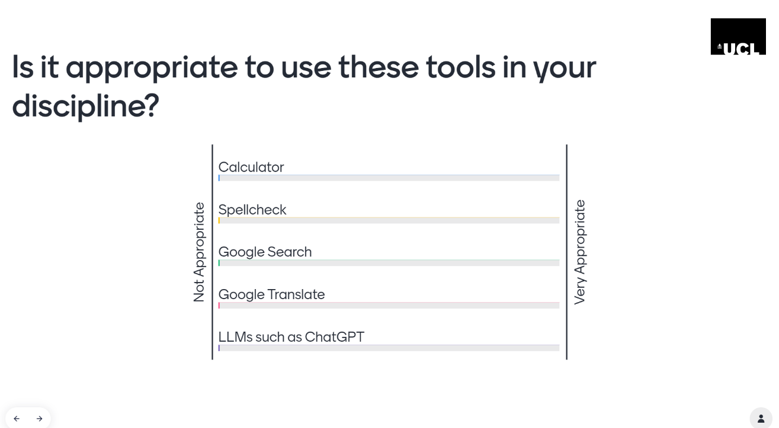
Is it appropriate to use these tools in your discipline?
Notes:
The mentimeter can be found as a template. Log in to mentimeter.com using Single Sign On (SSO). Click on “Shared templates” and search for “AI and You”.

Slide 15
Option 2: Discuss student perspectives on ethical usage of generative AI
The purpose of this activity is to discuss student perspectives on the ethical usage of generative AI. You may wish to begin by asking students how they would define ethical usage of AI in their disciplinary context.
You could then ask students to apply this definition to various scenarios using a mentimeter (see next slide) or, if you have a smaller group, an interactive whiteboard such as mural. Is it appropriate in your discipline for students to use generative AI to translate text, solve equations, or write copy?
The student contributions should prompt a discussion around what we mean by ethical usage and why they are using generative AI. Are students using generative AI to enhance their learning, or will its use impede them from achieving their learning goals?
A subsequent discussion might address whether what is appropriate usage for their learning might be different in a professional context. You might reflect with students on when it is appropriate to use AI in your own research. Would you use AI to write a research paper? Why, or why not?
Notes:
https://app.mural.co/template/ac35a201-5c55-4772-9b66-64288fe1eda6/95a77756-fa03-457b-812b-5f2b580fb80c

Slide 16
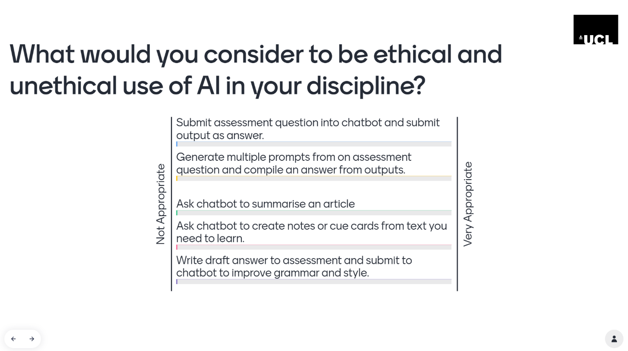
Option 2: Discuss ethical usage of AI
Notes:
The mentimeter can be found as a template. Log in to mentimeter.com using Single Sign On (SSO). Click on “Shared templates” and search for “AI and You”.

Slide 17
Option 3: Critique of an AI-generated output in your discipline
There is a great deal of press coverage that suggests that AI can complete undergraduate assignments with ease. But is that really the case? The purpose of this exercise is to engage students in a discussion about what they can and can’t do with AI in your discipline.
The first step is to provide students with an AI-generated output. You may wish to prepare this in advance, or could ask students to generate this themselves during the session.
Ask students to evaluate the output with reference to the module’s marking criteria or rubric. What are the strengths and weaknesses of the output? Where might the output meet the criteria, and where might it struggle? Are there any errors or hallucinations in the output and do students feel confident that they can spot them? Would they feel comfortable submitting this as a summative assessment? Would this be cheating? What would be the impact on their learning?
Alternatively, could they make productive use of this generated output to enhance their learning? What steps might they take to build upon this output?
In the following slides, you can see two examples from History and Physics of exam answers generated by ChatGPT4. You may reuse these examples or create your own.

Slide 18
Can ChatGPT succeed in an exam in UCL History?
Is it helpful to view nations as real or imagined?
The question of whether nations are real or imagined entities constitutes a central debate in the field of nationalism studies. This discussion grapples with the intricate interplay between tangible elements such as territory, economy, and governance, and the intangible aspects, such as shared culture identity, and historical memory that shape a nation. Three influential theorists – Benedict Anderson, Ernest Gellner, and Anthony D. Smith – provide distinct perspectives on this debate.
Anderson, in his seminal work, “Imagined Communities,” introduces the concept of nations as socially constructed ‘imagined’ entities, bound by a shared sense of identity despite their citizens rarely meeting face-to-face. Gellner, on the other hand, situates nations in the context of industrialization and modernization, suggesting that they are ‘real’ entities that emerge to meet the homogenization demands of modern societies. Meanwhile, Smith bridges these views with his ethno-symbolist approach, arguing that nations are both ‘real’ – rooted in historical ethnic communities – and ‘imagined’ – constructed through shared symbols and collective memory.
In this essay, we will delve into each theorist’s perspective to better understand whether it is more beneficial to view nations as ‘real’ tangible entities or ‘imagined’ social constructs, and what these perspectives can offer in our understanding of national identities. The exploration of these three viewpoints will illuminate the multifaceted nature of nations, underlining the complexity inherent in answering whether nations are real or imagined.
Benedict Anderson’s groundbreaking concept of “imagined communities” provides a compelling framework for understanding nations primarily as socially constructed entities. In his words, “the nation is imagined because the members of even the smallest nations will never know most of their fellow-members, meet them, or even hear of them, yet in the minds of each lives the image of their communion” (Anderson, 1983, p. 6).
Here is an answer I generated on ChatGPT-4 based on the prompt: Is it helpful to view nations as real or imagined?
Spend five minutes reading the answer in full. What are your first impressions? Is it an engaging answer? Does it answer the question? Are there any mistakes or “hallucinations,” and do you feel confident that you could spot them?
Now turn to our undergraduate marking criteria. Where might this answer meet the criteria, and at what level? Where does it fail to meet the criteria?
Notes:
Strengths: Paragraph 2 provides a decent summary of the works of Anderson, Gellner, and Smith, who are indeed three major theorists on nations and nationalism from the late twentieth century. The quote from Anderson in paragraph 4 is accurate.
Weaknesses: Paragraph 1 is a weak introduction that writes around the question, rather than offering an answer. Paragraph 3 is likewise writing around the question instead of engaging with it. The answer does not engage with any literature published in the twenty-first century. The quote in Paragraph 4 is not contextualised. We would expect students to use the revised second edition of Imagined Communities, published in 2006, rather than the first edition published in 1983. Indeed, the second edition is assigned as required reading and is readily available as an e-book, whereas the 1983 edition is not actually available from UCL Library.

Slide 19
Can ChatGPT succeed in an exam in UCL History? (contd.)
Argument and Writing | Evidence and Knowledge | Concepts and Historiography
Analytical introduction that sets the parameters and defines key terms. | Comprehensive knowledge and sophisticated understanding of subject | Good command of concepts relevant to the question
Logical structure enables close engagement with question throughout | Primary and secondary sources provide concise historical detail in ways which are concise, relevant, and analytical | Ability to analytically deploy concepts within argument
Develops coherent and cogent argument that culminates in a clear conclusion. | Moves between generalisations and detailed discussions with confidence and originality | Extensive reading and critical analysis of the historiography
Fluent, coherent, grammatical, accurate writing with appropriate references and bibliography | Independent use of knowledge and evidence that goes beyond paragraphing of other historians | Evaluates the type of historical argument found in the literature, including an appreciation of methodology
Excellent command of scholarly vocabulary to sustain complex argument | Critically reflects on nature and scope of evidence available | Identifies contradictions and disagreements within historiography and positions argument within debate
Is it helpful to view nations as real or imagined?
The question of whether nations are real or imagined entities constitutes a central debate in the field of nationalism studies. This discussion grapples with the intricate interplay between tangible elements such as territory, economy, and governance, and the intangible aspects, such as shared culture identity, and historical memory that shape a nation. Three influential theorists – Benedict Anderson, Ernest Gellner, and Anthony D. Smith – provide distinct perspectives on this debate.
Anderson, in his seminal work, “Imagined Communities,” introduces the concept of nations as socially constructed ‘imagined’ entities, bound by a shared sense of identity despite their citizens rarely meeting face-to-face. Gellner, on the other hand, situates nations in the context of industrialization and modernization, suggesting that they are ‘real’ entities that emerge to meet the homogenization demands of modern societies. Meanwhile, Smith bridges these views with his ethno-symbolist approach, arguing that nations are both ‘real’ – rooted in historical ethnic communities – and ‘imagined’ – constructed through shared symbols and collective memory.
In this essay, we will delve into each theorist’s perspective to better understand whether it is more beneficial to view nations as ‘real’ tangible entities or ‘imagined’ social constructs, and what these perspectives can offer in our understanding of national identities. The exploration of these three viewpoints will illuminate the multifaceted nature of nations, underlining the complexity inherent in answering whether nations are real or imagined.
Benedict Anderson’s groundbreaking concept of “imagined communities” provides a compelling framework for understanding nations primarily as socially constructed entities. In his words, “the nation is imagined because the members of even the smallest nations will never know most of their fellow-members, meet them, or even hear of them, yet in the minds of each lives the image of their communion” (Anderson, 1983, p. 6).
Notes:
Argument and Writing. Introduction is not analytical and does not define terms. Answer does not engage closely with the question or develop coherent argument. Writing is grammatical and accurate but reference is to an older edition of the text. Excellent command of scholarly vocabulary but does not sustain complex argument.
Evidence and Knowledge. Demonstrates knowledge of subject. Provides concise overview but not analytical. Does not move beyond generalisations (i.e. no detailed case study.) Does not go beyond quoting/paraphrasing. Does not reflect on evidence.
Concepts and Historiography. Some understanding of concepts but not deployed analytically. No extensive reading or analysis of modern literature. Does not evaluate type of argument or methodology. Does identify contradictions and disagreements but does not position argument (as it does not articulate one.)

Slide 20
Can ChatGPT solve physics problems?
Consider the following 2-part physics problem, what do you think of ChatGPT’s answer to the first part?
(1) If a deployment of stratospheric aerosol geoengineering adds 10 million tons of Sulphur to the stratosphere every year, and 10 million tons of sulphur is rained out per year, what is the average amount of sulphur deposited per unit area of the earth per year?
(2) If the global average rainfall rate is 3 mm/day, how much sulphur would be added to each litre of rainfall?
Part 1 ChatGPT Answer
To calculate the average amount of sulfur deposited per unit area of the Earth, we need to determine the net amount of sulfur added to the stratosphere. Since 10 million tons of sulfur are added each year, and 10 million tons are rained out per year, we can assume that the net addition is zero. Therefore, on average, there would be no additional sulfur deposition per unit area of the Earth due to this process.
Notes:
Solution: ChatGPT has worked out the net flux into the stratosphere (0 Mt/yr), rather than the rate of deposition (10 Mt/yr).

Slide 21
Can ChatGPT solve physics problems? (2)
Part 2 ChatGPT Answer
Determine the total amount of rainfall per year:
Average rainfall rate = 3 mm/day
There are 365 days in a year.
Total rainfall per year = (3 mm/day) * (365 days/year)
= 1,095 mm/year
Convert the total rainfall from millimeters to meters:
1 meter = 1,000 millimeters
Total rainfall per year = 1,095 mm/year / 1,000
= 1.095 meters/year
Calculate the volume of rainfall per year:
The surface area of the Earth is approximately 510 million square kilometers.
Total volume of rainfall per year = (1.095 meters/year) * (510 million square kilometers)
Convert the volume of rainfall from cubic meters to liters:
1 cubic meter = 1,000 liters
Total volume of rainfall per year = (1.095 meters/year) * (510 million square kilometers) * (1 billion liters/cubic meter)
= 558.45 billion liters/year 5. Determine the amount of sulfur added to each liter of rainfall:
Total sulfur added per year = 10 million tons
Amount of sulfur added to each liter of rainfall = (10 million tons) / (558.45 billion liters/year)
Review the answer to the second part, can you identify any issues with its solution?
(1) If a deployment of stratospheric aerosol geoengineering adds 10 million tons of Sulphur to the stratosphere every year, and 10 million tons of sulphur is rained out per year, what is the average amount of sulphur deposited per unit area of the earth per year?
(2) If the global average rainfall rate is 3 mm/day, how much sulphur would be added to each litre of rainfall?
Notes:
Solution:
The initial steps are all well-chosen and calculated correctly, until step 4.
The conversion factor from cubic meters to liters is off by several orders of magnitude, i.e., it should be 1 thousand rather than 1 billion
The total volume of rain has also been badly miscalculated and is off by a factor of 1 million, the result should be 558.45 x 10^15 litres/yr
Step 5 is the final step, but ChatGPT has not calculated a final answer.
The units used in the final step also don’t match, they should either both be per year or not.

Slide 22
3. What are UCL’s rules on academic integrity and AI?

Slide 23
AI and Assessments
UCL has developed three categories to provide guidance for when and how students can use generative AI in their assessments. Each category describes a general approach with examples. You are free to adapt these categories, offer additional clarification, and include different examples. The three categories are:
Category 1: Students are not allowed to use generative AI for their assessment beyond what is specified in the UCL Academic Manual (9.2.2b).
Category 2: Students are permitted to use generative AI tools for specific purposes to assist with their assessment.
Category 3: Generative AI is an integral part of the assessment and students are supported and encouraged to use it extensively.
Departments and/or module leaders will need to decide which category to employ for their assessments in advance. This should be communicated to students in a standardised manner. Assessment cover sheets could include a statement for students to declare “I have read, understood and abided by the restrictions on the use of generative AI for this assignment.”

Slide 24
Category 1
Students are not allowed to use generative AI for their assessment.
This category is for assessments demonstrating foundation level skills such as independently developing critical thinking skills, and applying knowledge or demonstrating fundamental skills that will be required throughout the programme.
You are not permitted to use AI tools for your assessment beyond the areas permitted by the UCL Academic Manual (9.2.2b) or in specified exceptions for students with a Statement of Reasonable Adjustment (SoRA).
UCL Academic Manual (9.2.2b) permits students to use software to check areas of academic writing such as structure, grammar, spelling, punctuation, and language translation. However, this may be considered Academic Misconduct if substantive changes to content have been made by the software, or in cases of language translation if the student is being assessed on their ability to translate or use a language other than English.

Slide 25
Category 2
Students are permitted to use generative AI tools for specific purposes to assist with their assessment.
AI tools can be utilised to enhance and support the development of specific skills in specific ways, as specified by the tutor and required by the assessment. For instance, students might use AI for tasks such as data analysis, pattern recognition, or generating insights. Here the tutor should support and guide the students in the use of AI to ensure equity of experience, but the use of AI is not in itself a learning outcome. There will be some aspects of the assessment where the use of AI is inappropriate.

Slide 26
Category 3
Generative AI is an integral part of the assessment and students are supported and encouraged to use it extensively.
AI can be used as a primary tool throughout the assessment process. Students will demonstrate their ability to use AI tools effectively and critically and critically to tackle complex problems, make informed judgments, and generate creative solutions. The assessment will provide an opportunity to demonstrate effective and responsible use of AI. The tutor should support and guide the students in the use of AI to ensure equity of experience

Slide 27
Acknowledging use of generative AI
Generative AI should not be included as a citation or reference (unless specified by your programme). UCL, like most publishers, has stipulated that large language models cannot be considered an author. This is because they cannot take responsibility for their work and they do not generate original ideas. Rather, they reformulate ideas found elsewhere, without acknowledgement. It is also impossible for the reader to refer to the original source.
Instead, your use of generative AI should be acknowledged UCL’s rules on academic integrity state that you must be transparent in your use of AI. You must therefore acknowledge when you have used generative AI to assist you in the creation of your academic work, such as editing your prose, translating words or generating an image.
As a minimum, your acknowledgement should include the name, version, and URL of the generative AI tool and a brief description of the context in which the tool was used. For example:
I acknowledge the use of artificial intelligence tools in the production of this report. ChatGPT3.5 (https://chat.openai.com/) was used to provide an initial summary of focus group transcripts.
Refer to UCL’s guidelines and check whether additional requirements are stipulated for your assignment.

Slide 28
4. What are our next steps?

Slide 29
How might students use AI?
Role | Description | Example of implementation
Possibility engine | AI generates alternative ways of expressing an idea | Students write queries in ChatGPT and use the Regenerate response function to examine alternative responses.
Socratic opponent | AI acts as an opponent to develop and argument | Students enter prompts into ChatGPT following the structure of a conversation or debate. Teachers can ask students to use ChatGPT to prepare for discussions.
Collaboration coach | AI helps groups to research and solve problems together | Working in groups, students use ChatGPT to find out information to complete tasks and assignments.
Personal tutor | AI tutors each student and gives immediate feedback on progress | ChatGPT provides personalized feedback to students based on information provided by students or teachers (e.g., test scores).
Study buddy | AI helps the student reflect on learning material | Students explain their current level of understanding to ChatGPT and ask for ways to help them study the material. ChatGPT could also be used to help students prepare for other tasks (e.g., job interviews).
Motivator | AI offers games and challenges to extend learning | Teachers or students ask ChatGPT for ideas about how to extend students’ learning after providing a summary of the current level of knowledge (e.g., quizzes, exercises).
Dynamic assessor | AI provides educators with a profile of each student’s current knowledge | Students interact with ChatGPT in a tutorial-type dialogue and then ask ChatGPT to produce a summary of their current state of knowledge to share with their teacher/for assessment.
Notes:
The roles and descriptions were created by Mike Sharples (Professor Emeritus of Educational Technology, Open University, UK). The examples of implementation were devised by UNESCO IESALC and also draw from suggestions by Ronald Knust Graichen (Education Consultant, the Netherlands) published at https://eduteka.icesi.edu.co/articulos/KNUST-como-usar-chatGPT-en-el-aula.

Slide 30
Any Questions?

